Slide 1
What is Mixed Reality
Mickey MacDonald – Technical Evangelist
@Scruffyfurn
Notes:
Please call out that you are not part of the product teams in Redmond

Slide 2


Slide 3
PHYSICAL REALITY
DIGITAL REALITY
The state of things as they “actually exist” through our human senses without any technology.
Artificially created sensory experiences of people, environments and objects, which can include sight, touch, hearing, and smell.
Notes:
To keep it simple we have two universes today: one that is based on atoms and the laws of physics and another that is based on bits and digital logic.
These universes have their corresponding realities: a physical reality and a digital reality.

Slide 4
PHYSICAL REALITY
DIGITAL REALITY
The blending of physical and digital worlds
MIXED REALITY
Notes:
Now, thanks to Windows 10 and its capability to understand you and your world, we can blend these realities: the digital into the physical the physical into the digital and create what we call Mixed Reality.
In May 2016 we announced that Mixed Reality is coming to Window PCs
The Windows Mixed Reality technology combined with the power of the PC with the latest Virtual Reality innovation will enable new Mixed Reality experiences that are simply not possible on any other platform.
This will enable the most complete offering across the widest range of Head Mounted Displays ranging from fully immersive virtual reality to fully untethered holographic computing.

Slide 5
Mixed reality spectrum
Mixed reality blends the physical and digital worlds to produce new environments where physical and digital objects co-exist and can be interacted with as if all of them were real.
MIXED REALITY (MR)
PHYSICAL REALITY
DIGITAL REALITY
AR today
VR today
Windows Mixed Reality – Holographic headsets (see-through)
Windows Mixed Reality – Immersive headsets (occluded)
Windows Mixed Reality requires
Perception/environment awareness
Any mix of people, places or things
Notes:
Let’s define the Mixed Reality Spectrum. <click>
On the left hand side
we have the <click> physical reality in which we, humans, exist.
Then, on the right hand side we have the corresponding <click> digital reality.
Let’s say we are in the physical reality on the left, if we start to bring something from the digital, like a digital representation of a person, place, or thing, and mix it into the physical <click>
Or, let’s say we are in the digital reality on the right, if we start to bring something from the physical, like a real physical person, place, or thing, and mix it into the digital <click>
Then <click>, anything in between is mixed reality.
Most <click> AR and <click> VR offerings today represent a very small part of this spectrum. They are, however, subsets of the superset, which is mixed reality more broadly.
Windows Mixed Reality <click> requires that the computer is capable of perception, or environment awareness, and can be represented by any mix of physical (real), or digital representations of people, places, or things.
There are two main types of devices that deliver Windows Mixed Reality experiences.
The first, <click> are holographic devices with see-through lenses, like Microsoft HoloLens.
The second, <click> are immersive devices with opaque, non see-through displays.
Both of these device types offer Windows Mixed Reality experiences that exist on the spectrum between the physical and digital realities.

Slide 6

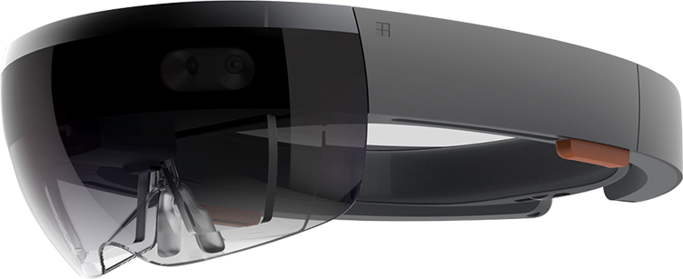






Windows Mixed Reality headsets
Head mounted displays (HMDs) that provide mixed reality experiences by leveraging the native Windows Mixed Reality experiences in Windows 10.
Notes:
It’s the magic behind the experiences available across our OEM and HoloLens devices. It’s the platform that allows for rich user experiences that merge our real world and our digital world
(FTE note: similar to Windows Hello – we could imagine Windows Mixed Reality running across a variety of mobile or desktop devices).
Mixed Reality is the future of computing and Windows makes jumping in easier than ever before
Head-Mounted Display Hardware: Microsoft HoloLens is the first mixed reality device to track user movement across six degrees of freedom
User Experience: Windows 10 is the first operating system designed to operate the way people do
Consumer Applications: The world’s largest catalog of apps grows with new franchise titles and experiences on Xbox and Windows
Commercial Applications: A brand new platform for global institutions and government to transform the way we work and achieve more
3D Images and 360 Video: Windows 10 is the world’s leading platform for beautiful image capture and viewing in three dimensions

Slide 7
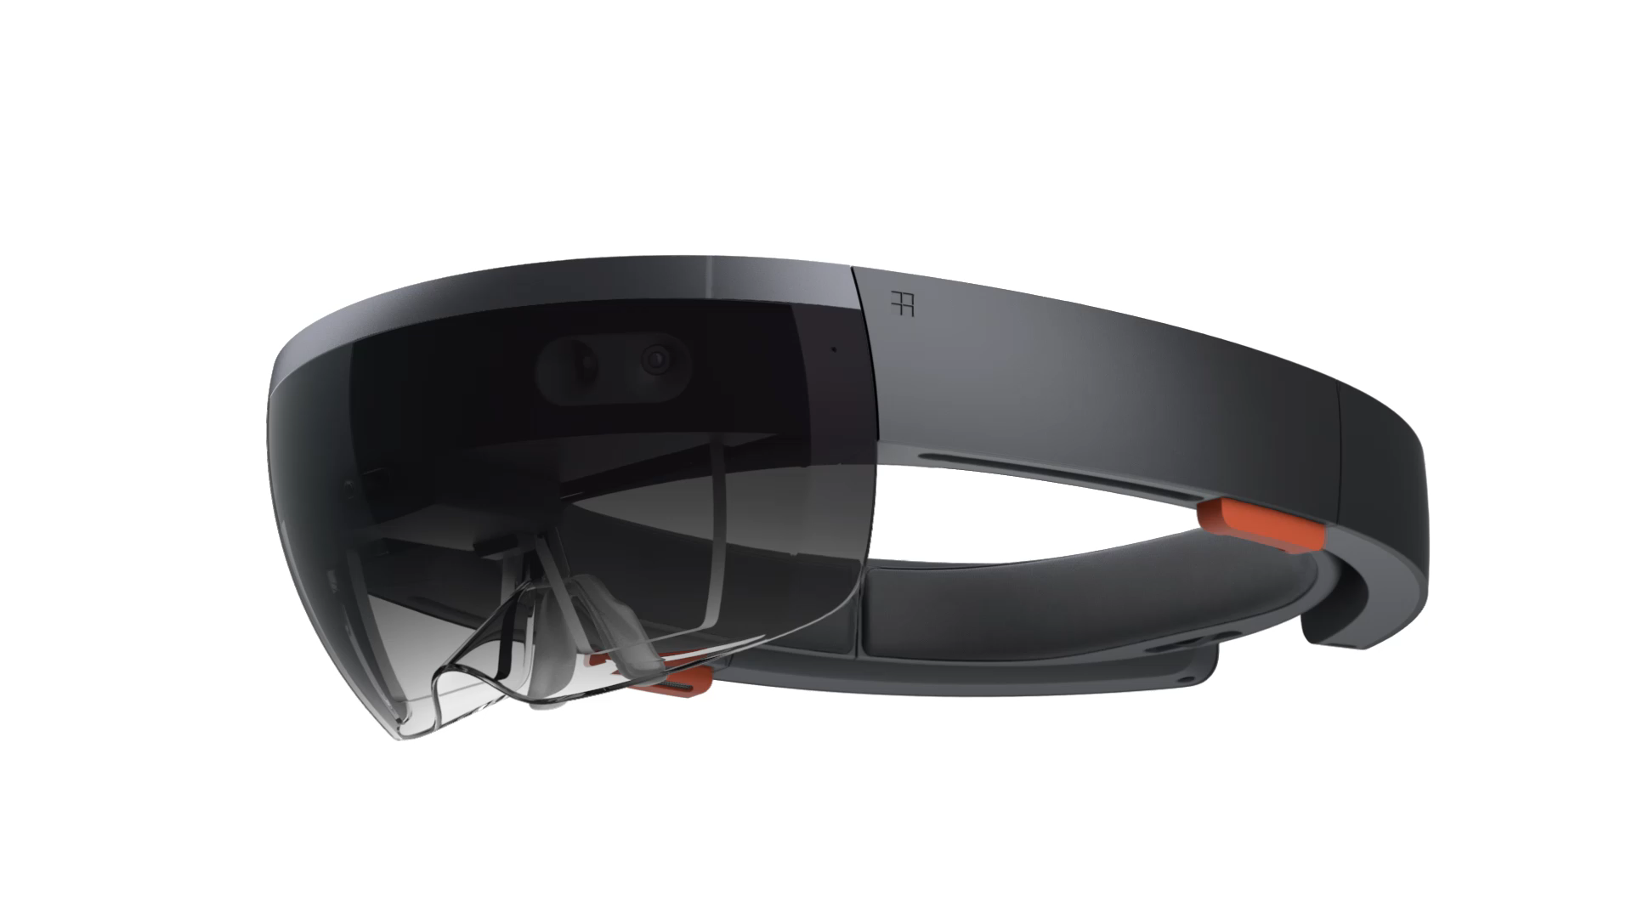
Holographic headsets
Untethered computer
Containing more computing power than the average laptop, Microsoft HoloLens doesn’t need external wires, markers, or cameras, nor a connection to a phone or PC, so you can move freely and untethered.
Advanced sensors
Microsoft HoloLens has advanced sensors to capture information about what you're doing and the environment you’re in.
Transparent lenses
See-through holographic lenses use an advanced optical projection system, so you can see holograms in your world.
Holographic Processing Unit
The HPU is custom silicon that processes a large amount of data per second from the sensors, enabling Microsoft HoloLens to understand gestures, where you look, and map the world around you, all in real time.
Spatial sound
Microsoft HoloLens synthesizes sound so that you can hear holograms from anywhere in the room. It’s immersive, yet won’t block out the real world.

Slide 8
Immersive headsets
So easy to set up: works out-of-box
You start naturally with the Mixed Reality Portal app preloaded on the Windows 10 PCs. The setup, calibration and learning is so easy. And Windows Mixed Reality remembers your space: it uses presence to recall the space you've set up before the next time you dawn the headset where you've played before.
More freedom to place the system where you want
Get more freedom to move from the system from room to room. No installation of trackers or sensors in the wall is needed with inside-out tracking. Six-degrees-of-freedom and 4m long cables.
Wide range of affordable headsets and PCs
Choose from a variety of affordable headsets starting at $299. Those pair perfectly with a breadth of Windows Mixed Reality-ready PCs, starting at $499, and get the same flawless experience
The largest apps library in the category 20k+
Most of the things you do today on your PC work in Windows Mixed Reality, plus 360º videos or anything shot in 360º, games, apps from HoloLens and more.

Slide 9
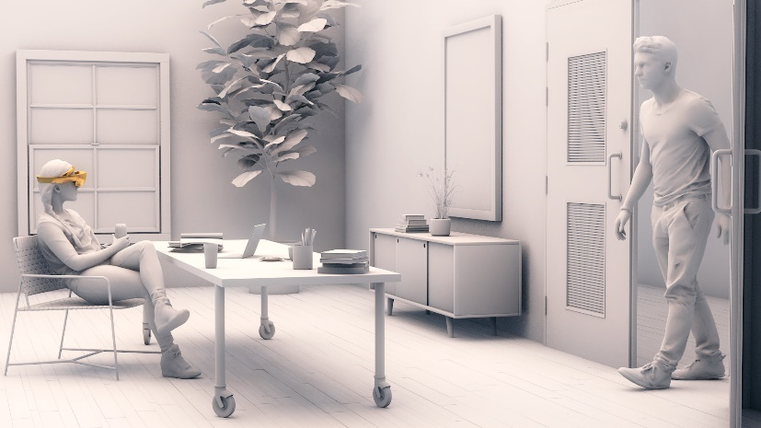
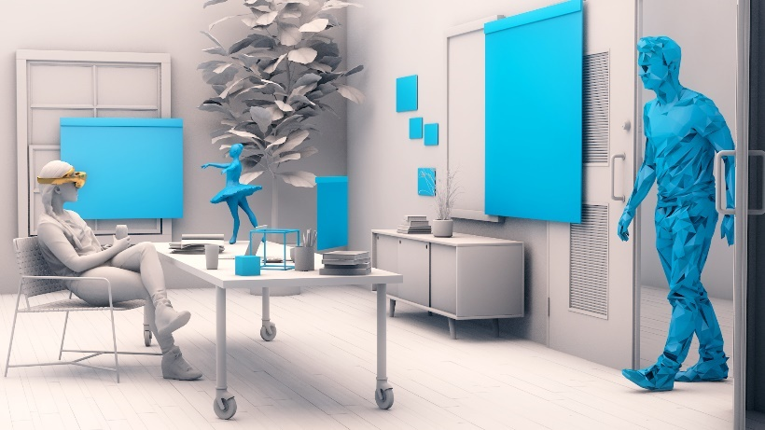
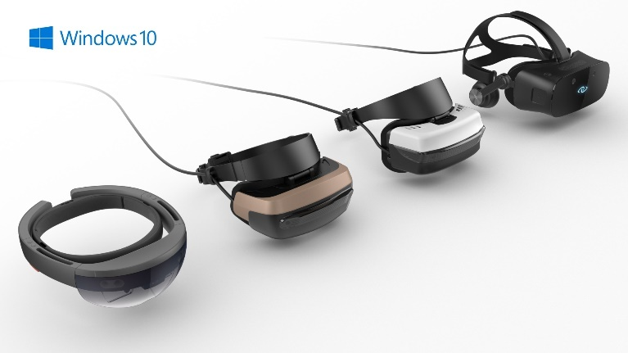
What is Windows Mixed Reality?
Windows 10 devices enabled Windows Mixed Reality experiences.
New ways to connect, create, and explore
Holograms enhancing the world around you
Advanced technology such as inside-out tracking and 6DOF
Notes:
Release your apps from flat screens with Windows Mixed Reality. Create fully untethered experiences on HoloLens, the world’s first self-contained, holographic computer. Or add new dimensions to PC applications every time a user plugs in a Windows Mixed Reality headset. From fully immersive VR games, to highly powerful enterprise solutions, Windows Mixed Reality gives you the flexibility to create experiences that enable and excite.
Join Microsoft in bringing mixed reality to the mainstream. We’re partnering with leading hardware makers on a wide range of affordable Windows Mixed Reality headsets, starting at $299, that pair with Windows Mixed Reality-ready PCs, starting at $499. We’ve simplified user setup with inside-out tracking technology, eliminating room size requirements and the need for external sensors. Users can navigate their virtual environments with familiar inputs, while business customers can feel more secure knowing it’s all build on Windows 10.
The path to developing mixed reality software may be shorter than you think. With an app model, tools. and UX common to all Windows devices, development skills can be applied to PCs, HoloLens, Xbox and experiences on Windows Mixed Reality headsets. With Windows Mixed Reality headsets starting at $299, learning and prototyping is less expensive than in other PC-headset ecosystems.

Slide 10
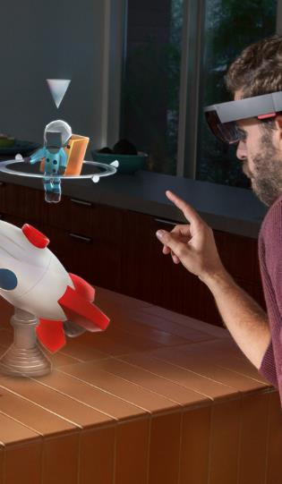
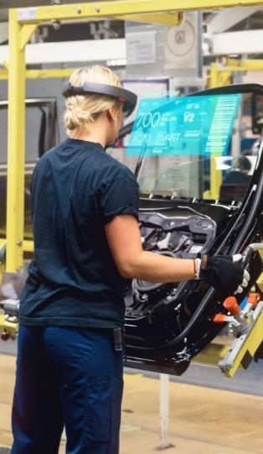

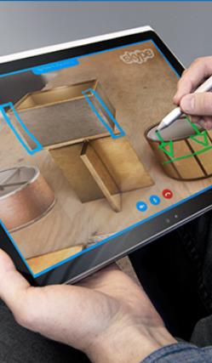
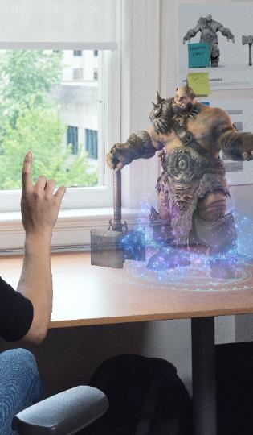
Build great things
Creation & Design
Assembly & Manufacturing
Training & Development
Communication & Understanding
Entertainment & Engagement
Notes:
Creation and design – the ability to see and manipulate 3D designs in real time, in a real world setting, at true size and scale.
Assembly and manufacturing – the ability to synthesize complex data sets and provide visual displays that aid in navigation and operations.
Training and development – the ability to explain complex scenarios visually, with movement and in three dimensions.
Communication and understanding – the ability to provide remote expert assistance. Seeing through the eyes of a remote user and provide annotations that appear as holographic content through HoloLens.
Entertainment and engagement – the ability to experience entertainment content in more personal and immersive ways.

Slide 11
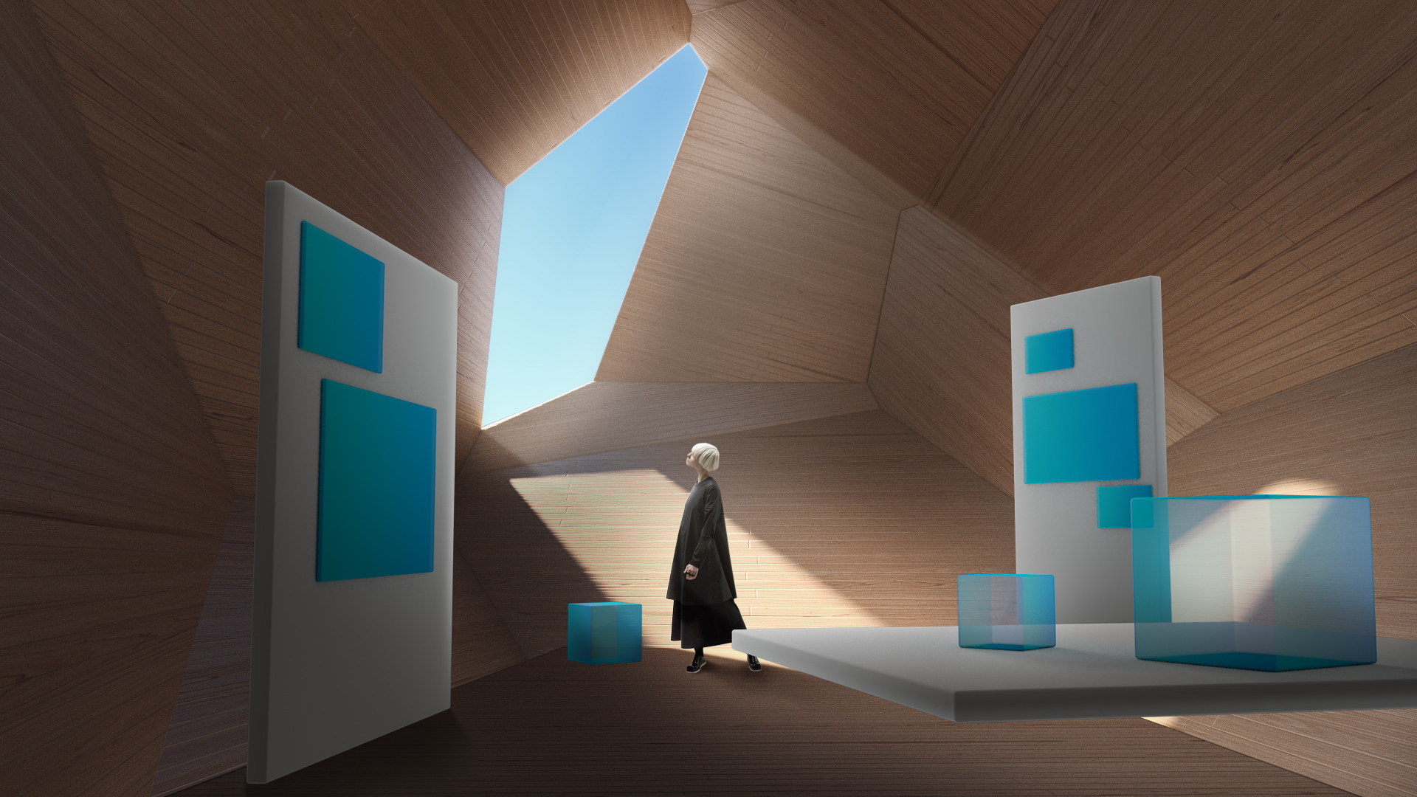
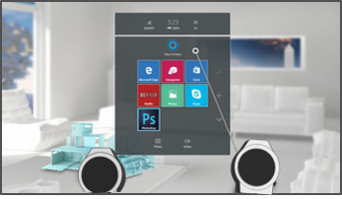
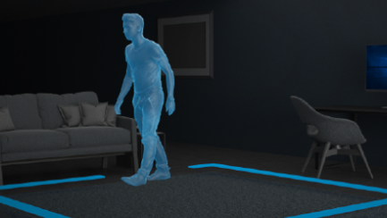

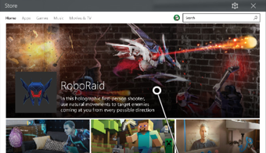
What makes us different?
Freedom of movement
Single, consistent user interface
More choice, more customers
Effortless setup
One SDK for many devices
Windows Store for mixed reality apps
Notes:
Freedom of movement: Experience virtual reality in any room of your house. Experience complete freedom with 6DOF tracking.
Effortless Setup: Works right out of the box, no need to drill holes or setup extraneous hardware. Windows does all the work.
Single, Consistent User Interface: Windows provides a consistent interface across varied Mixed Reality devices.
One SDK for many devices: Build apps using the familiar Windows development tools you already know and love, and have them run across multiple HMDs.
More consumer choice: With HoloLens and multiple OEM partners, Windows Mixed Reality is available on a wide range of devices, giving the consumer more freedom.
More sales channels: Monetize and promote your app from day one in the Windows Store, merchandising in a Store optimized for VR and holographic apps.
More customers: By targeting a larger variety of PC specs, Windows Mixed Reality opens the door to reach more consumers than ever before.

Slide 12
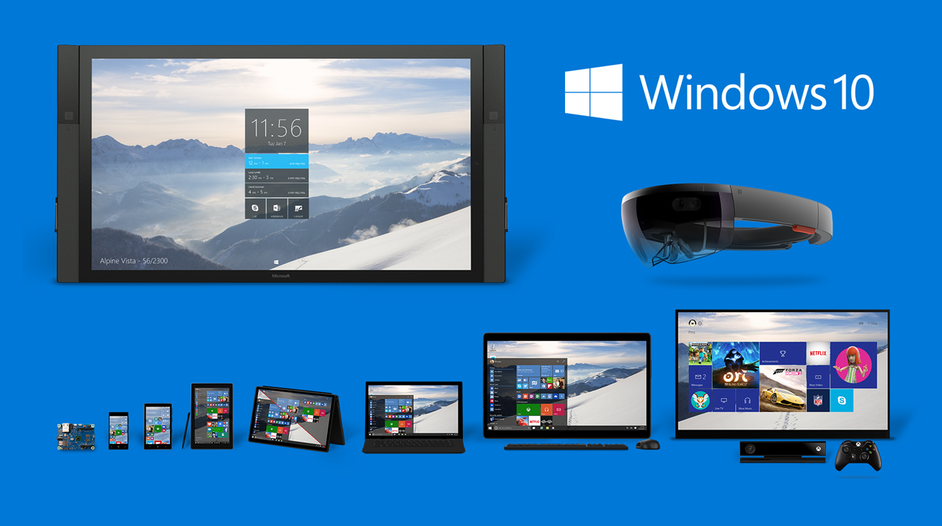
One platform. Multiple Windows devices.
One Universal Windows Platform
Windows Mixed Reality is built into the Windows SDK that developers already use today
The Universal Windows Platform makes it easy to build an application that scales from HoloLens to other mixed reality headsets.
Target windows.holographic for holographic headsets
Target windows.desktop for immersive headsets
Windows is the only platform unifying the mixed reality ecosystem, providing inside-out tracking for headsets, a single platform and standardized inputs for developers, and a consistent interface with a single store for customers.​
Full details at dev.windows.com/mixed-reality
Notes:
Because HoloLens and the upcoming mixed reality headsets both share the same Universal Windows Platform for building apps, an app built for HoloLens can also run as an immersive experience on mixed reality headsets powered by the Windows 10 Creators Update
You can build apps that take advantage of the spectrum of Windows Mixed Reality headsets, from the see-through lenses and spatial mapping of HoloLens, to occluded headsets from Acer, ASUS, Dell, HP, Lenovo, and 3Glasses. And these new headsets will start in the $300 range, so your mixed reality app can reach more users than ever before.

Slide 13
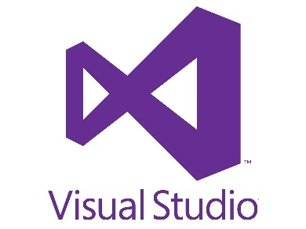
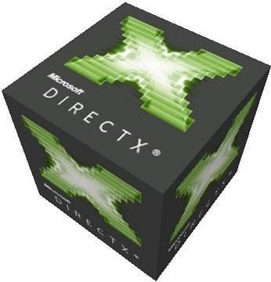
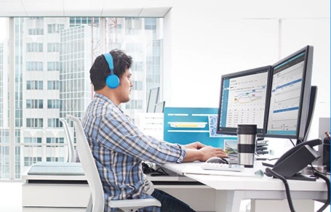
Familiar development tools
Games
Middleware
Visual Studio 15 and 17 toolchain works with the Windows SDK to let you build Windows Mixed Reality apps.
We support development against DirectX 11 and 12, allowing you to build your own custom solutions.
Universal Dev Center is the ingestion tool for Universal Windows Platform (UWP) apps including Windows Mixed Reality apps.
Growing ecosystem of available middleware with more options coming onboard frequently.
Let us know which middleware you are dependent on.

Slide 14
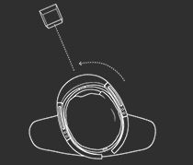
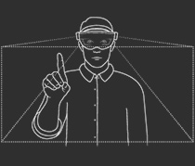
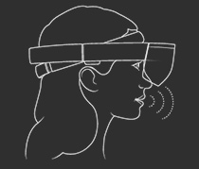
Input diversity
Mixed Reality with Windows 10 allows a variety of inputs such as motion controllers, gamepads, mice, keyboards, gaze, and voice.
Holographic
Immersive
Gaze tells you where the user is looking in the world and lets you determine their intent.
☑
☑
Gesture input lets you interact with your holograms naturally using your hands or a clicker.
Game pads – Navigate, target, scroll, zoom, select.
Mouse and keyboard: Point, click, text input.
☑
☑
☑
Voice allows you to directly command a hologram without having to use gestures. You simply gaze at a hologram and speak your command.
☑
☑
Notes:
Pre-read for speaker: https://developer.microsoft.com/en-us/windows/mixed-reality/gaze
Pre-read for speaker: https://developer.microsoft.com/en-us/windows/mixed-reality/gestures
Pre-read for speaker: https://developer.microsoft.com/en-us/windows/mixed-reality/voice_input
Pre-read for speaker: https://developer.microsoft.com/en-us/windows/mixed-reality/spatial_mapping
Pre-read for speaker: https://developer.microsoft.com/en-us/windows/mixed-reality/spatial_sound
Pre-read for speaker: https://developer.microsoft.com/en-us/windows/mixed-reality/coordinate_systems

Slide 15
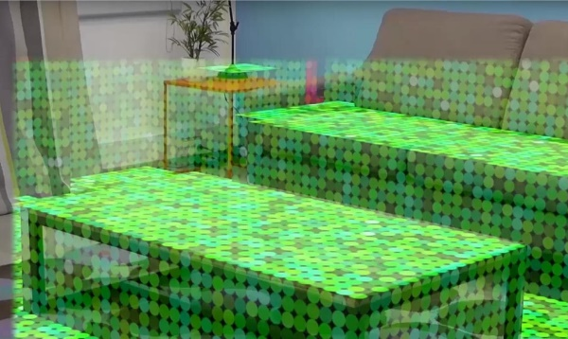

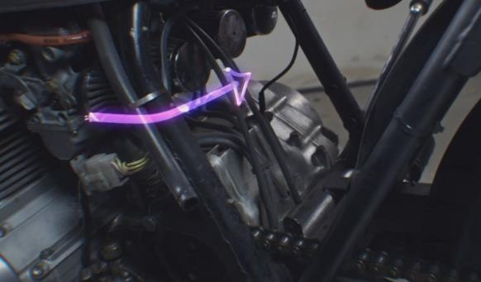
A new way to interact
Gaze
Gesture
Voice commands
Spatial mapping
Spatial sound
World coordinates
Notes:
To make holograms possible, Windows exposes an entirely new set of features to developers. There are six fundamental building blocks for mixed reality holographic apps:
World coordinates
Gaze input
Gesture input
Voice input
Spatial sound
Spatial mapping
Interaction with HoloLens has been designed around gaze, gesture and voice. This is sometimes referred to as GGV. The environmental understanding features like coordinates, spatial sound and spatial mapping provide the ability for holograms to interact with both the user and the world around them.
Holograms are made of light and sound, which depends on rendering. Understanding the experience of placement and persistence, as demonstrated in the HoloLens shell is a great way ground yourself in the user experience.

Slide 16
Porting existing VR apps to Windows Mixed Reality
Code checklist
Port your app to the Universal Windows Platform
Validate Middleware and Tooling support of Windows Mixed Reality APIs
Replace current VR SDKs with Windows Mixed Reality APIs
Design considerations
Design assets for the mixed reality shell (live cubes)
Evaluate Windows MR functionality such as world scale in your game
Focus on consistent performance and frame rate target across HMD
Testing and publishing
Validate performance across a range of PCs and HMDs.
Validate certification requirements for the Windows Store
Publish to the Windows Store..

Slide 17
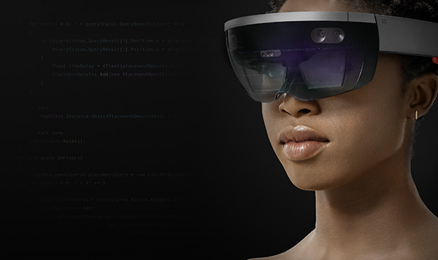
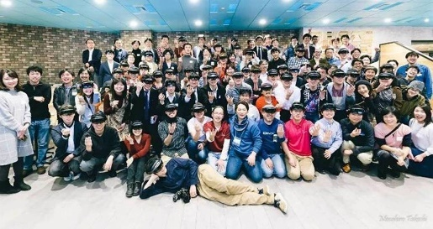
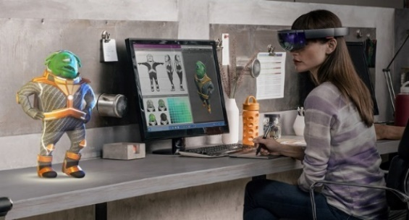
Start building mixed reality apps today
Online tools & resources
dev.windows.com/mixedreality
Download the tools
aka.ms/hololensdevtools
Follow the training
aka.ms/holographicacademy
Forums.hololens.com
Questions, discussion, and feedback from the mixed reality development community.
aka.ms/GaGithub/microsoft
laxyExplorer
aka.ms/holotoolkitunity
aka.ms/holotoolkit
aka.ms/windowsdeviceportalwrapper
aka.ms/holographicacademygithub
Join the community
aka.ms/iwantmr
Join MR@MS: A program tailored to your needs, providing guidance and support from ideation to publish.
aka.ms/MRcommunity
Technical Evangelists - Connect with one of our technical evangelists in your area.
Meetups: join one of the hundreds of meetups around the world
Work with our teams or our agencies
aka.ms/MRcommunity
Microsoft Technology Centers
Experience HoloLens & discuss core business uses
aka.ms/agencies
Agency partners have HoloLens development expertise and dedicated teams to take on application development for clients.
mpcbdesk@microsoft.com
Our teams will work with you from envisioning, to proof of concepts, all the way to deployment.
Notes:
MPCbdesk@microsoft.com > business desk
MPCSales@microsoft.com > sales team

Slide 18
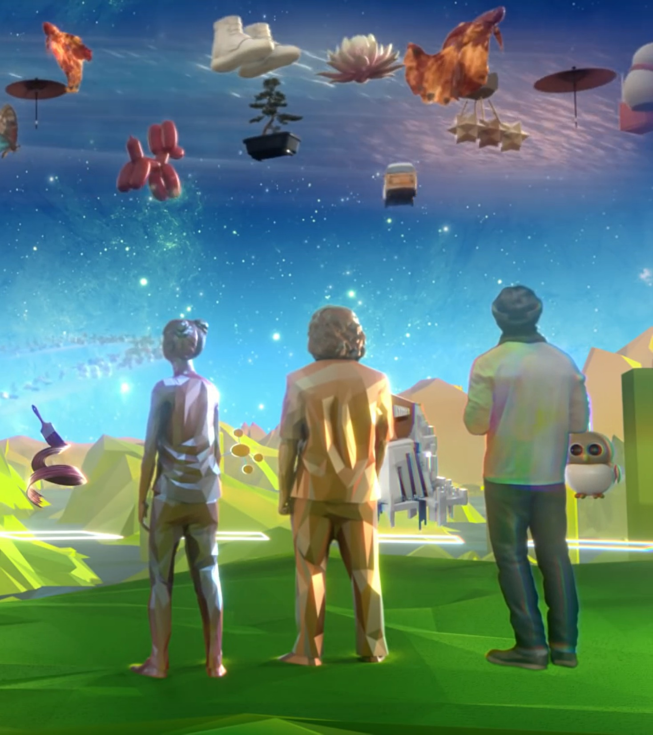
Thank you
Mickey MacDonald – Technical Evangelist, Microsoft Canada
@Scruffyfurn

